Slide 1
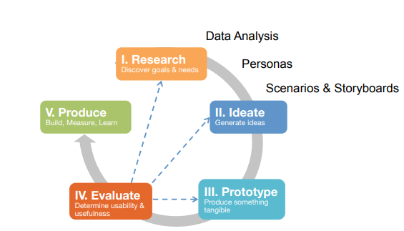
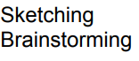
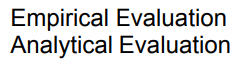
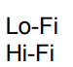
Design Process

Slide 2
Inspection methods | User testing
Evaluate the prototype without users (e.g. Heuristic Evaluation) Guess how users could use the interfaces | Evaluate the prototype with users Observe how users use the interfaces

Slide 3
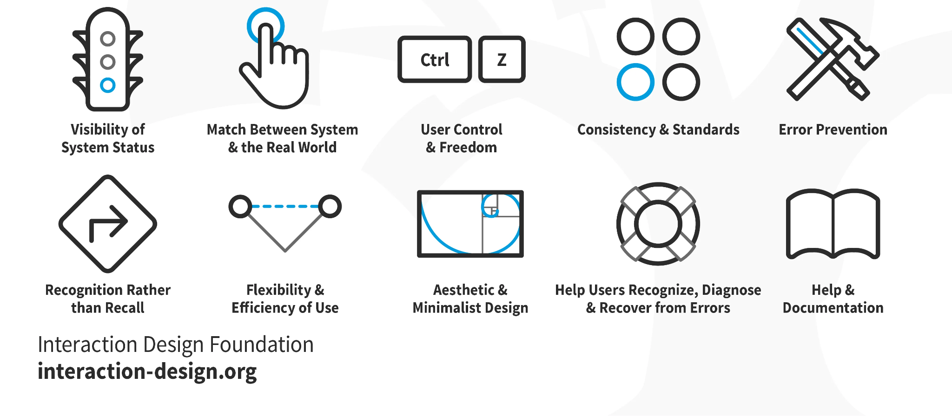
Inspection Methods

Slide 4

Inspection Methods
What are Inspection Methods?
Notes:
Great – now let’s get on with Inspection methods.
Inspection methods are an integral method to have in your toolbelt. Even if you don’t go into HCI or user experience – people are going to ask for your opinion on things and you can use the skills from today to help you.
Inspection method are a systematic approach to evaluating an interface or product. We can use them anytime in the design process, but I especially like using them when we have a mid to high fidelity prototype before we start developing the system. It typically does not involve the user and they are fairly quick. But…you have to be an ”expert” in HCI methods – you have to know how to do them to do. It… and you have to remember that these are essentially guesses – right?

Slide 5
Inspection Methods
Pros
Does not involve user(s)
Relatively quick to perform
Used anytime during design process

Slide 6
Inspection Methods
Pros
Cons
Does not involve user(s)
Relatively quick to perform
Used anytime during design process
Need an expert
Guesses of what would happen
Do not find all problems (may only find 75%)

Slide 7
Evaluate a digital artifact through a set of usability principles or well-accepted rules of golden design, known as “heuristics”
A HE helps evaluate the overall design;
The more heuristics you consider, the more comprehensive your evaluation will be;
Focus/choose heuristics, which are relevant to your project;
Heuristic Evaluation
(HE)
What is it?
Heuristic Evaluation
Notes:
The first inspection method we are going to talk about is Heuristic evaluation… [go through points]

Slide 8
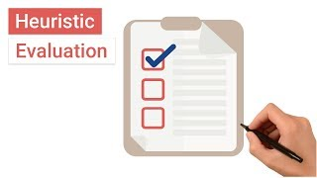
Heuristic Evaluation
(HE)
→ Overview
→ 10 Heuristics
Notes:
How do we do this…review points.

Slide 9
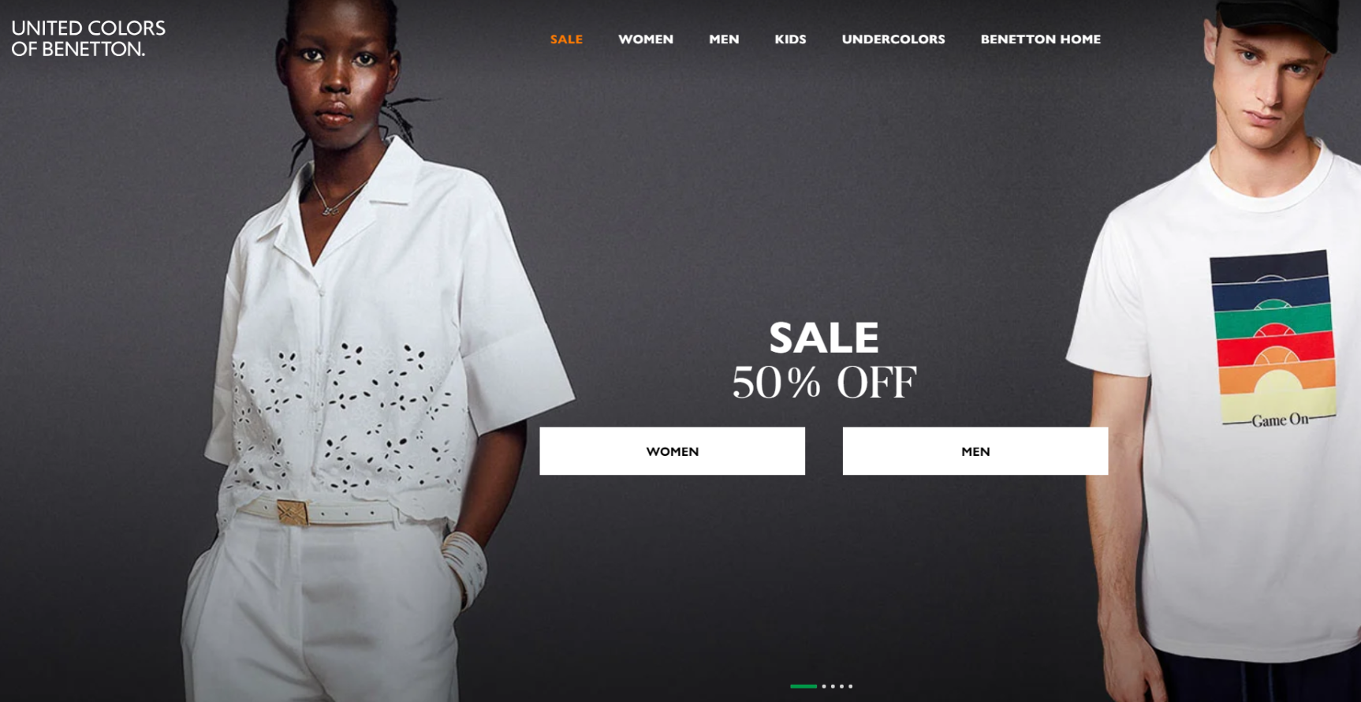
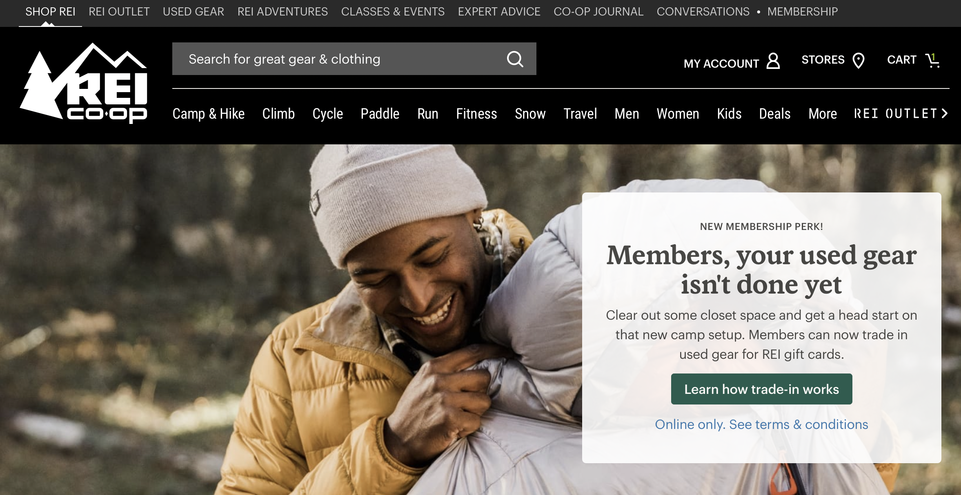
Heuristic Evaluation
(HE)
How?
→ Create a Task
A well-designed task tells the user:
what they need to do
without how to do it

Slide 10
Heuristic Evaluation
(HE)
How?
→ Create a Task
A well-designed task tells the user:
what they need to do
without how to do it
We have re-designed an online store for clothes.
What are some good tasks to evaluate our design?

Slide 11
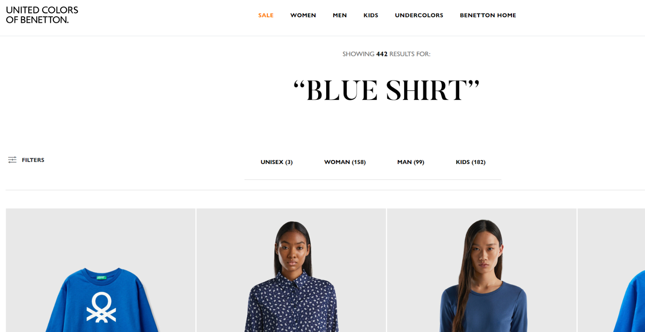
Heuristic Evaluation
(HE)
How?
→ Create a Task
A well-designed task tells the user:
what they need to do
without how to do it
✅ You want to purchase a new shirt for your mother.

Slide 12
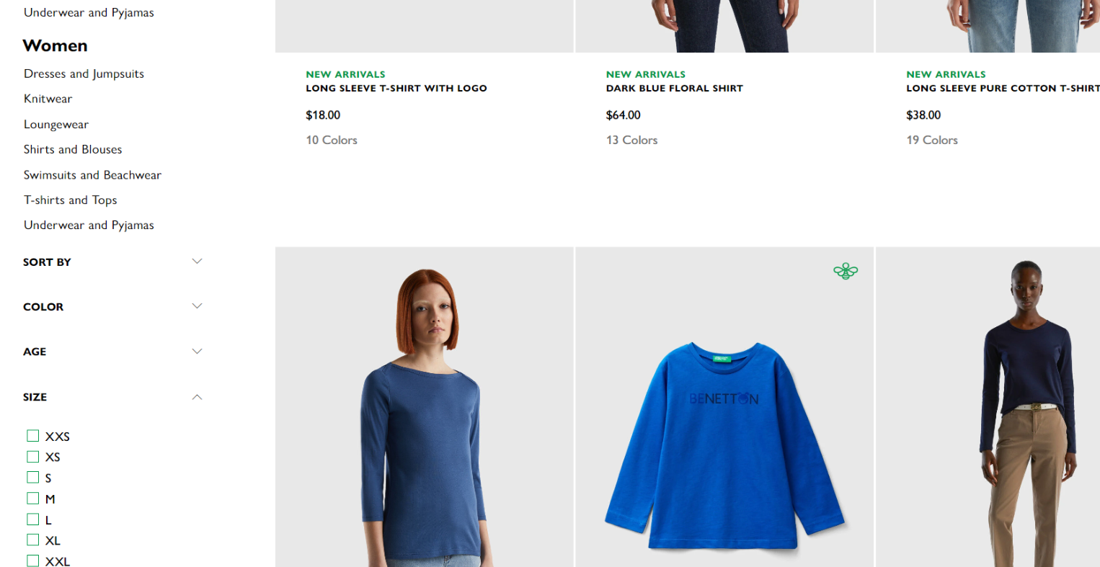
Heuristic Evaluation
(HE)
How?
→ Create a Task
A well-designed task tells the user:
what they need to do
without how to do it
✅ You want to purchase a new shirt for your mother.
✅✅ You want to purchase a new blue shirt for your mother but you only have $25 Dollar to spent. She wears size M.

Slide 13
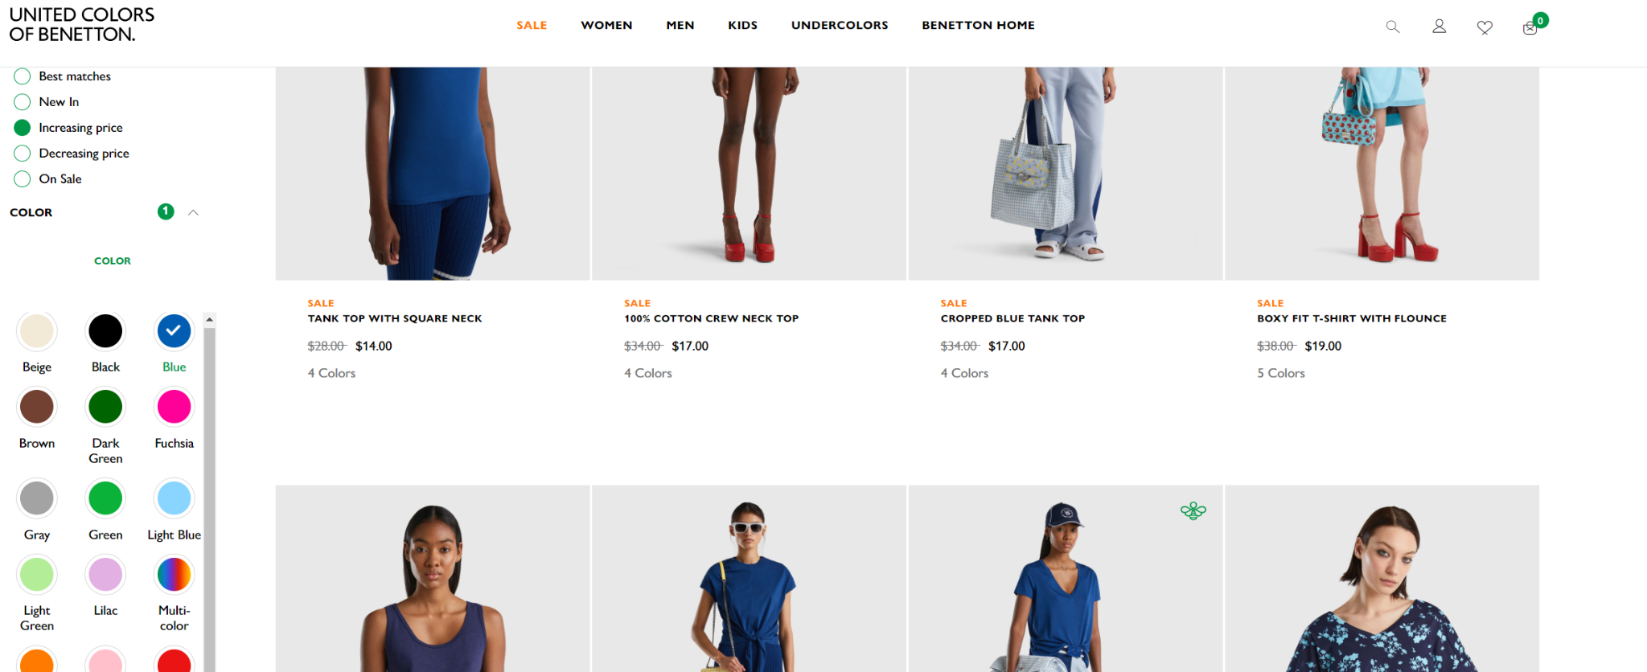
Heuristic Evaluation
(HE)
How?
→ Create a Task
A well-designed task tells the user:
what they need to do
without how to do it
✅ You want to purchase a new shirt for your mother.
✅✅ You want to purchase a new blue shirt for your mother but you only have $25 Dollar to spent. She wears size M.
❌❌❌ Click on Search, type “women’s shirt” and click enter. Then filter for size M, color blue and sort the results for below $25.

Slide 14
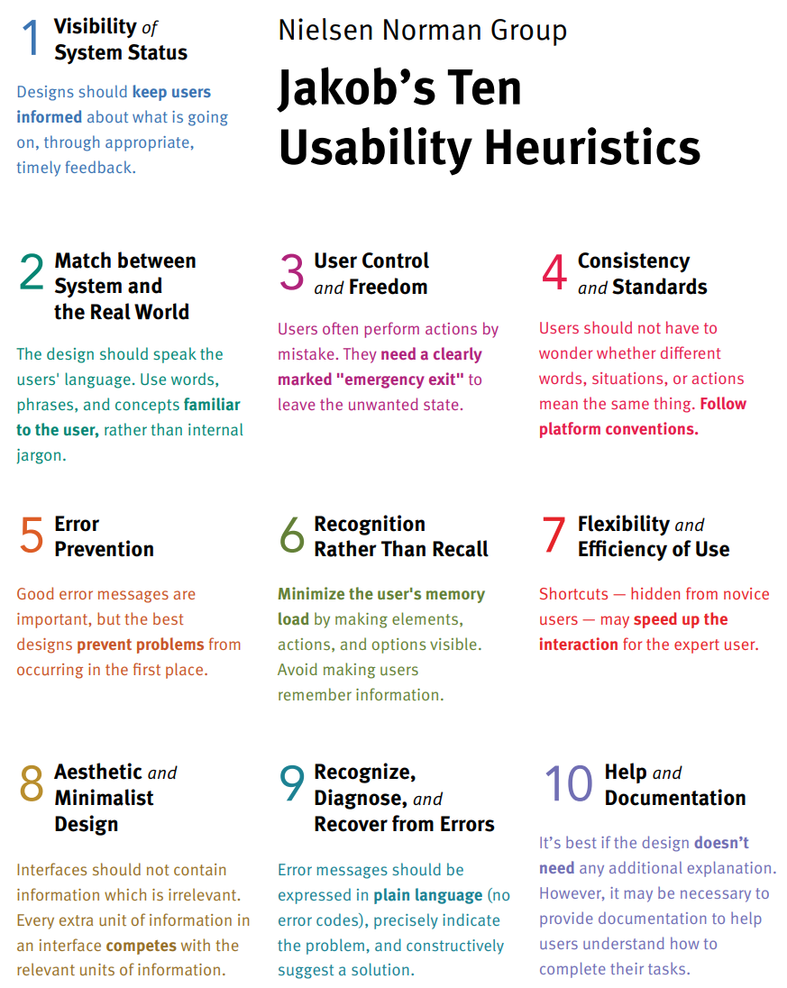
Heuristic Evaluation
(HE)
How?
What Heuristics to use?
Choose heuristics, which:
- are relevant to your project and prototype, including the critical tasks
- you understand and can use to review your prototype See here: https://www.nngroup.com/articles/ten-usability-heuristics/#poster
Notes:
How do we do this…review points.

Slide 15

Heuristic Evaluation
(HE)
How?
To rate Usability Problems?
How can we evaluate problems?
Are all usability problems in our designs of similar quality and significance?
Why? Why not?
Notes:
How do we do this…review points.

Slide 16
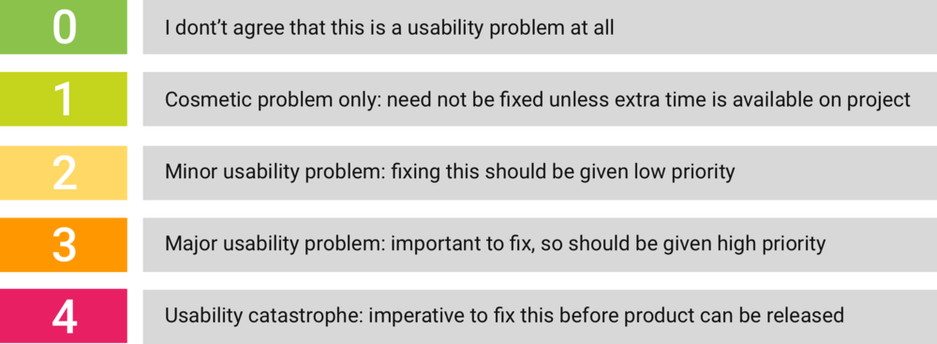
Heuristic Evaluation
(HE)
How?
To rate Usability Problems?
A Rating Scale for Severity of Problems
https://www.minamarashi.com/heuristic-evaluation
Notes:
How do we do this…review points.

Slide 17
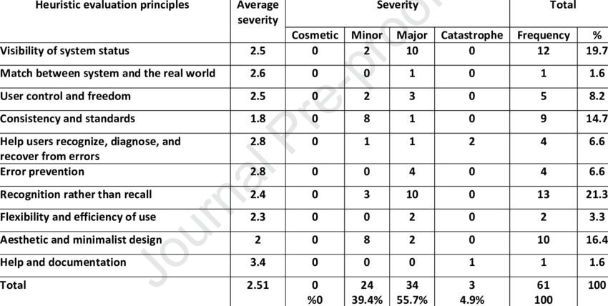
Heuristic Evaluation
(HE)
How?
To rate Usability Problems?
A Rating Scale for Severity of Problems
https://www.minamarashi.com/heuristic-evaluation
A consolidated HE by Heuristics
https://www.researchgate.net/figure/The-frequency-of-severity-of-problems-based-on-the-principles-of-heuristic-evaluation_tbl2_340895224
Notes:
How do we do this…review points.

Slide 18
Heuristic Evaluation
(HE)
How?
To rate Usability Problems?
Are the problems…
- … critically impeding the user / preventing the user from succeeding in their main task?
A Rating Scale for Severity of Problems
https://www.minamarashi.com/heuristic-evaluation
A consolidated HE by Heuristics
https://www.researchgate.net/figure/The-frequency-of-severity-of-problems-based-on-the-principles-of-heuristic-evaluation_tbl2_340895224
Notes:
How do we do this…review points.

Slide 19
Heuristic Evaluation
(HE)
How?
To rate Usability Problems?
Are the problems…
- … critically impeding the user / preventing the user from succeeding in their main task?
- … breaking the flow and the user can’t recover?
A Rating Scale for Severity of Problems
https://www.minamarashi.com/heuristic-evaluation
A consolidated HE by Heuristics
https://www.researchgate.net/figure/The-frequency-of-severity-of-problems-based-on-the-principles-of-heuristic-evaluation_tbl2_340895224
Notes:
How do we do this…review points.

Slide 20
Heuristic Evaluation
(HE)
How?
To rate Usability Problems?
Are the problems…
- … critically impeding the user / preventing the user from succeeding in their main task?
- … breaking the flow and the user can’t recover?
- … slowing down the user, but still allowing them to complete the task?
A Rating Scale for Severity of Problems
https://www.minamarashi.com/heuristic-evaluation
A consolidated HE by Heuristics
https://www.researchgate.net/figure/The-frequency-of-severity-of-problems-based-on-the-principles-of-heuristic-evaluation_tbl2_340895224
Notes:
How do we do this…review points.

Slide 21

Heuristic Evaluation
(HE)
→ Overview
→ 10 Heuristics
Notes:
How do we do this…review points.

Slide 22
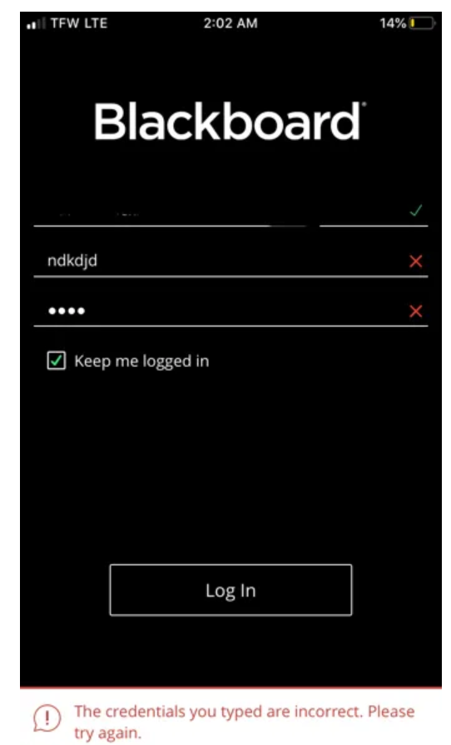
Heuristic Evaluation
(HE)
How?
To do the HE
https://medium.com/swlh/10-usability-heuristics-exemplified-57bbfdfd663e
Notes:
How do we do this…review points.

Slide 23
Heuristic Evaluation
(HE)
How?
To do the HE
What is wrong here?
What heuristics are violated?
https://medium.com/swlh/10-usability-heuristics-exemplified-57bbfdfd663e
Notes:
How do we do this…review points.

Slide 24
Heuristic Evaluation
(HE)
How?
To do the HE
What is wrong here?
What heuristics are violated?
→ #1 Visibility of System Status (not clear what is going on)
→ #5 Error prevention (the error message is not telling us what the problem is)
What’s the severity of the problem?
https://medium.com/swlh/10-usability-heuristics-exemplified-57bbfdfd663e
Notes:
How do we do this…review points.

Slide 25
Heuristic Evaluation
(HE)
How?
To do the HE
What is wrong here?
What heuristics are violated?
→ #1 Visibility of System Status (not clear what is going on)
→ #5 Error prevention (the error message is not telling us what the problem is)
What’s the severity of the problem?
→ 4 | Usability Catastrophe: If users can’t login, they can’t use the system.
https://medium.com/swlh/10-usability-heuristics-exemplified-57bbfdfd663e
Notes:
How do we do this…review points.

Slide 26
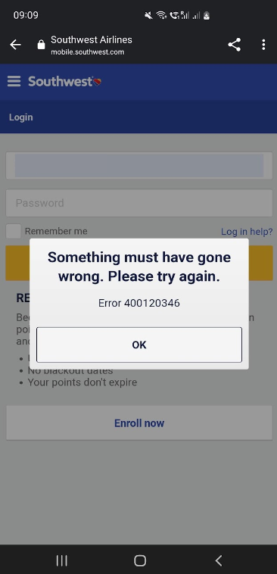
Heuristic Evaluation
(HE)
How?
To do the HE
https://www.https://www.southwest.com/
Notes:
How do we do this…review points.

Slide 27
Heuristic Evaluation
(HE)
How?
To do the HE
What is wrong here?
What heuristics are violated?
https://www.https://www.southwest.com/
Notes:
How do we do this…review points.

Slide 28
Heuristic Evaluation
(HE)
How?
To do the HE
What is wrong here?
What heuristics are violated?
→ #9: Help users recognize, diagnose, and recover from errors (what is Error 400120346?)
What’s the severity of the problem?
https://www.https://www.southwest.com/
Notes:
How do we do this…review points.

Slide 29
Heuristic Evaluation
(HE)
How?
To do the HE
What is wrong here?
What heuristics are violated?
→ #9: Help users recognize, diagnose, and recover from errors (what is Error 400120346?)
What’s the severity of the problem?
→ 4 | Usability Catastrophe: If users can’t login, they can’t use the system.
https://www.https://www.southwest.com/
Notes:
How do we do this…review points.

Slide 30
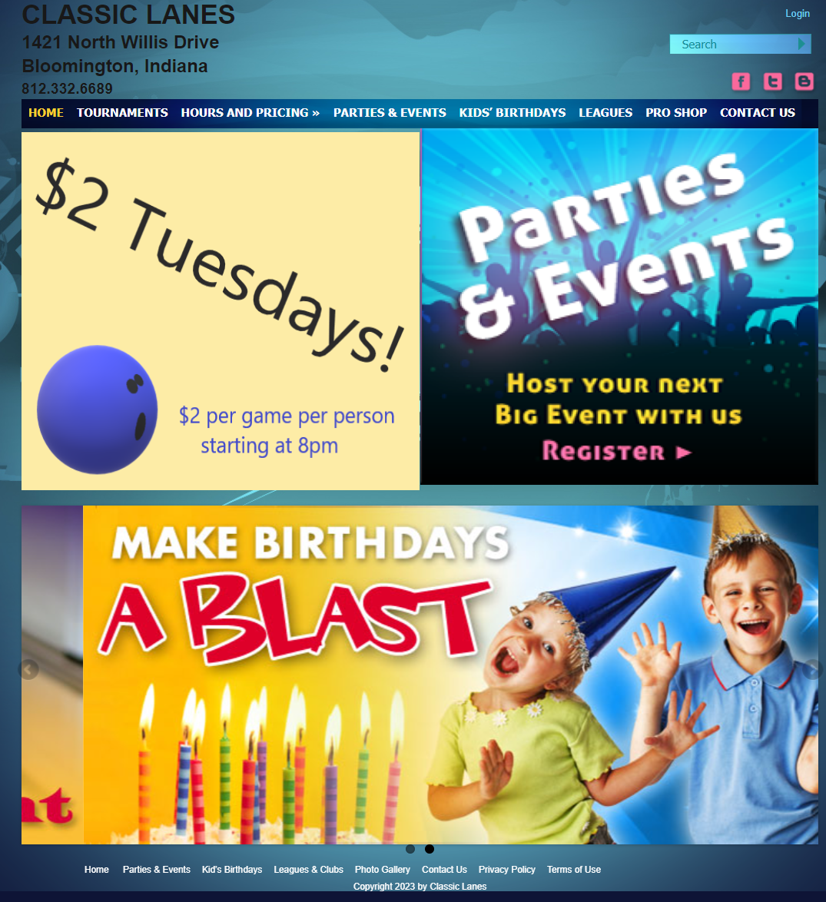
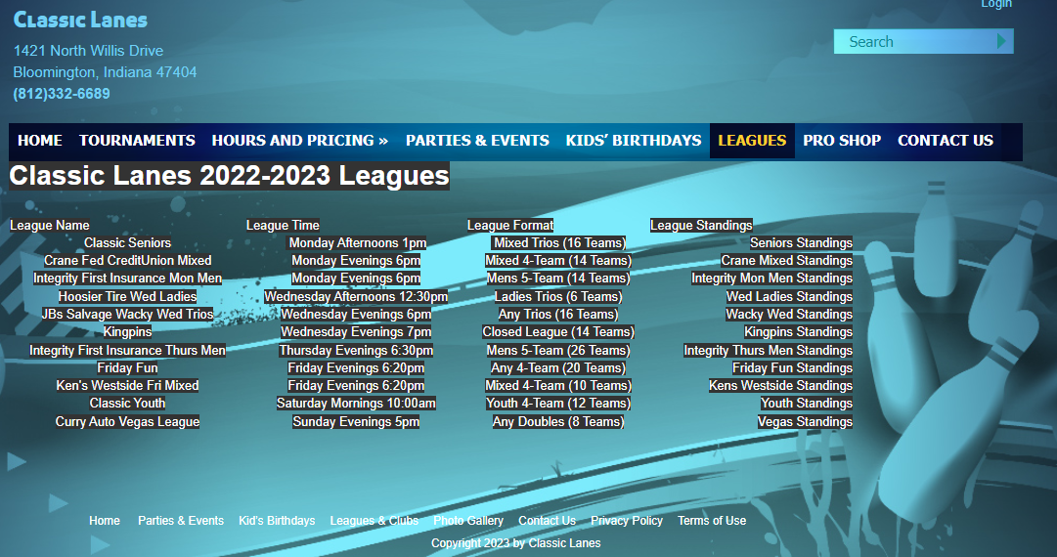
Heuristic Evaluation
(HE)
How?
To do the HE
https://www.classiclanesin.com/
Notes:
How do we do this…review points.

Slide 31
Heuristic Evaluation
(HE)
How?
To do the HE
What is wrong here?
What heuristics are violated?
https://www.classiclanesin.com/
Notes:
How do we do this…review points.

Slide 32
Heuristic Evaluation
(HE)
How?
To do the HE
What is wrong here?
What heuristics are violated?
→ #8: Aesthetic and minimalist design (Font-Background Contrast, switching font color, unreadable text, redundant menus, etc. )
What’s the severity of the problem?
https://www.classiclanesin.com/
Notes:
How do we do this…review points.

Slide 33
Heuristic Evaluation
(HE)
How?
To do the HE
What is wrong here?
What heuristics are violated?
→ #8: Aesthetic and minimalist design (Font-Background Contrast, switching font color, unreadable text, redundant menus, etc. )
What’s the severity of the problem?
→ 2 | Minor Usability Problem: Fixing this has low priority.
https://www.classiclanesin.com/
Notes:
How do we do this…review points.

Slide 34
Inspection methods | User testing
Evaluate the prototype without users (e.g. Heuristic Evaluation) Guess how users could use the interfaces | Evaluate the prototype with users Observe how users use the interfaces

Slide 35
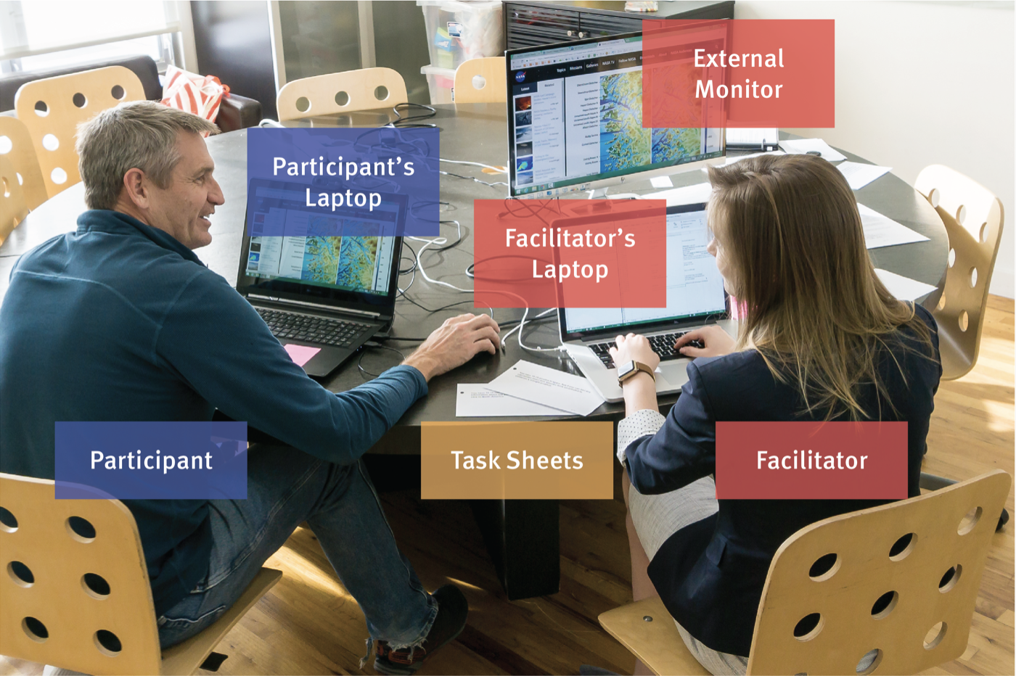
User Testing

Slide 36
What is user testing?
“User testing” means the same thing as “usability testing”.
It means “testing the interface with users.”
This lecture is developed from https://www.nngroup.com/articles/usability-testing-101/

Slide 37
What is user testing?
In a usability-testing session, a researcher (called a “facilitator” or a “moderator”) asks a participant to perform tasks, usually using one or more specific user interfaces.
Notes:
this picture illustrates a user testing setup.

Slide 38
What is user testing?
In a usability-testing session, a researcher (called a “facilitator” or a “moderator”) asks a participant to perform tasks, usually using one or more specific user interfaces.
While the participant completes each task, the researcher observes the participant’s behavior and listens for feedback.

Slide 39

Why user testing?
Notes:
https://www.youtube.com/watch?v=v8JJrDvQDF4

Slide 40

How to prepare for user testing?
Before user testing, you need to have:
A well-developed prototype
A set of written task instructions (N Tasks)
A user study protocol
Done a pilot study using your prototype
Notes:
You can explain the example a little. The task is clearly stated, but doesn’t suggest how to complete the task. The participants may need to check help menu on the printer. If you want to test whether the participant can discover help menu themselves or not, you don’t want to mention help menu in your task description.

Slide 41


User Study Protocol
A good user study protocol is a guide to HELP YOU facilitate the testing session with your participant.
It should introduce you and the project.
Notes:
You can explain the example a little. The task is clearly stated, but doesn’t suggest how to complete the task. The participants may need to check help menu on the printer. If you want to test whether the participant can discover help menu themselves or not, you don’t want to mention help menu in your task description.

Slide 42
User Study Protocol
A good user study protocol is a guide to HELP YOU facilitate the testing session with your participant.
It should introduce you and the project.
It should inform the participant about data collection, ask for consent and address any questions or concerns.
Notes:
You can explain the example a little. The task is clearly stated, but doesn’t suggest how to complete the task. The participants may need to check help menu on the printer. If you want to test whether the participant can discover help menu themselves or not, you don’t want to mention help menu in your task description.

Slide 43
User Study Protocol
A good user study protocol is a guide to HELP YOU facilitate the testing session with your participant.
It should introduce you and the project.
It should inform the participant about data collection, ask for consent and address any questions or concerns.
It should introduce a scenario (s) and task(s), as well as remind the participant to think out loud during the test.
Notes:
You can explain the example a little. The task is clearly stated, but doesn’t suggest how to complete the task. The participants may need to check help menu on the printer. If you want to test whether the participant can discover help menu themselves or not, you don’t want to mention help menu in your task description.

Slide 44
User Study Protocol
A good user study protocol is a guide to HELP YOU facilitate the testing session with your participant.
It should introduce you and the project.
It should inform the participant about data collection, ask for consent and address any questions or concerns.
It should introduce a scenario (s) and task(s), as well as remind the participant to think out loud during the test.
It should provide room for feedback and questions, before, during or after the test.
Notes:
You can explain the example a little. The task is clearly stated, but doesn’t suggest how to complete the task. The participants may need to check help menu on the printer. If you want to test whether the participant can discover help menu themselves or not, you don’t want to mention help menu in your task description.

Slide 45
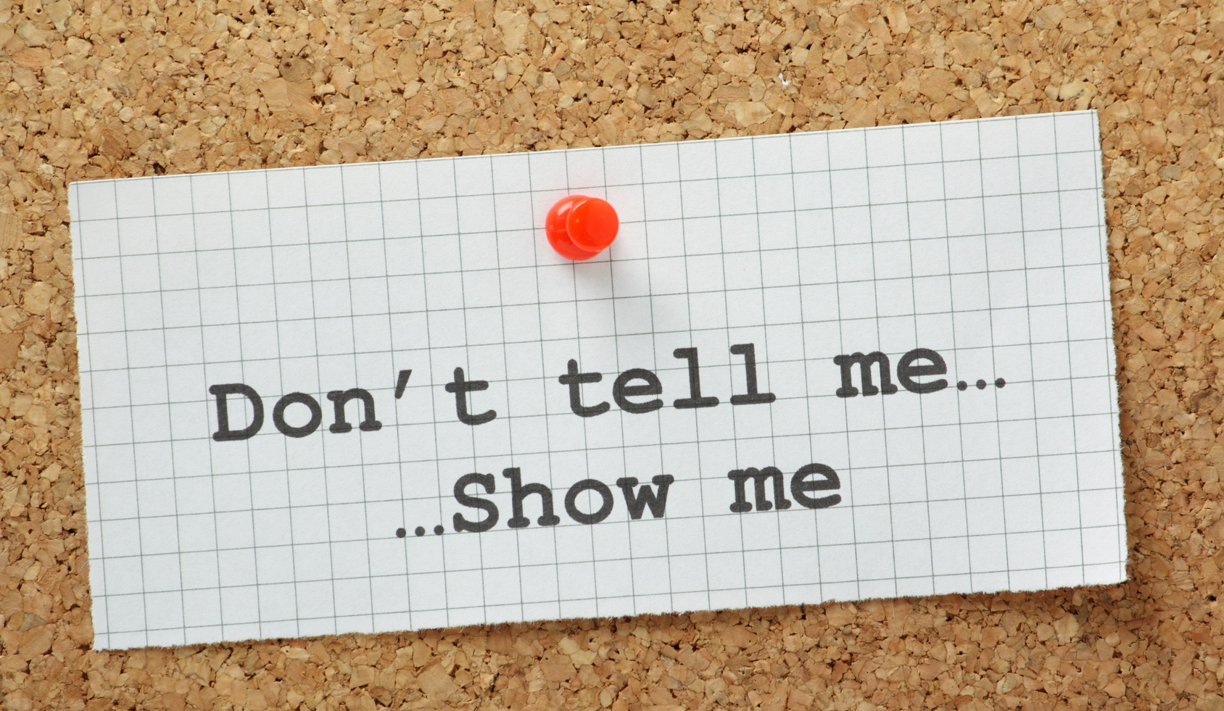
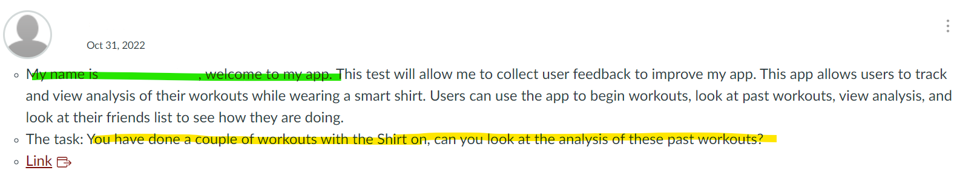
User Study Protocol Drafts
Examples
Good:
Introduction (yourself and project)
Introduction to Scenario and Task
Missing:
Opportunity for Questions
Informed Consent
Think out loud reminder
Notes:
You can explain the example a little. The task is clearly stated, but doesn’t suggest how to complete the task. The participants may need to check help menu on the printer. If you want to test whether the participant can discover help menu themselves or not, you don’t want to mention help menu in your task description.

Slide 46
Reminder on Scenarios and Tasks
Scenario?
A scenario provides context, via a short story. It tells why someone is using your interface, app or site. It “sets up” or “tees up” the task for the participant.
Task? The actual instruction of “telling the user what to do, without how to do it”
Notes:
Is this a good task for user testing?

Slide 47
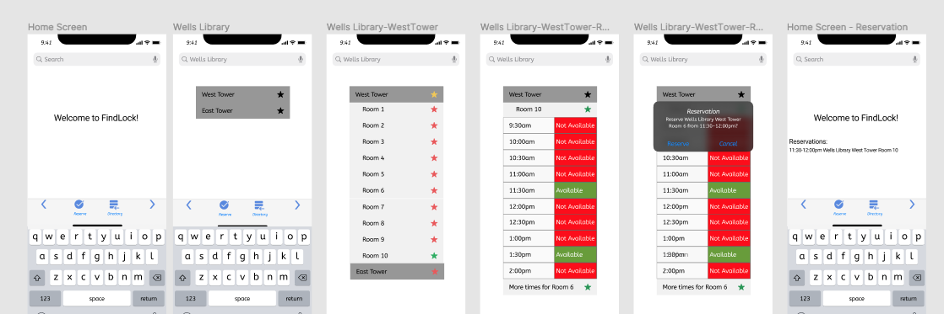
Reminder on Scenarios and Tasks
Scenario: You are an Informatics Student at IU and you need to take a Final Exam at noon in the Wells Library today. Upon arrival, you realize, you are a bit early and want to find a quiet place for last minute cramming. You pull out your phone and open up Findlock to book a room to study.
Task: Can you search and schedule a room in Wells Library from 11:30AM to noon?
Notes:
Is this a good task for user testing?

Slide 48
Reminder on Scenarios and Tasks
Scenario: You are an Informatics Student at IU and you need to take a Final Exam at noon in the Wells Library today. Upon arrival, you realize, you are a bit early and want to find a quiet place for last minute cramming. You pull out your phone and open up Findlock to book a room to study.
Task: Can you search and schedule a room in Wells Library from 11:30AM to noon?
Looks Good?
Notes:
Is this a good task for user testing?

Slide 49
Reminder on Scenarios and Tasks
Scenario: You are an Informatics Student at IU and you need to take a Final Exam at noon in the Wells Library today. Upon arrival, you realize, you are a bit early and want to find a quiet place for last minute cramming. You pull out your phone and open up Findlock to book a room to study.
Task: Can you search and schedule a room in Wells Library from 11:30AM to noon?
Good Scenario
but
the word “search” in the task can influence the participants.
Notes:
Is this a good task for user testing?

Slide 50
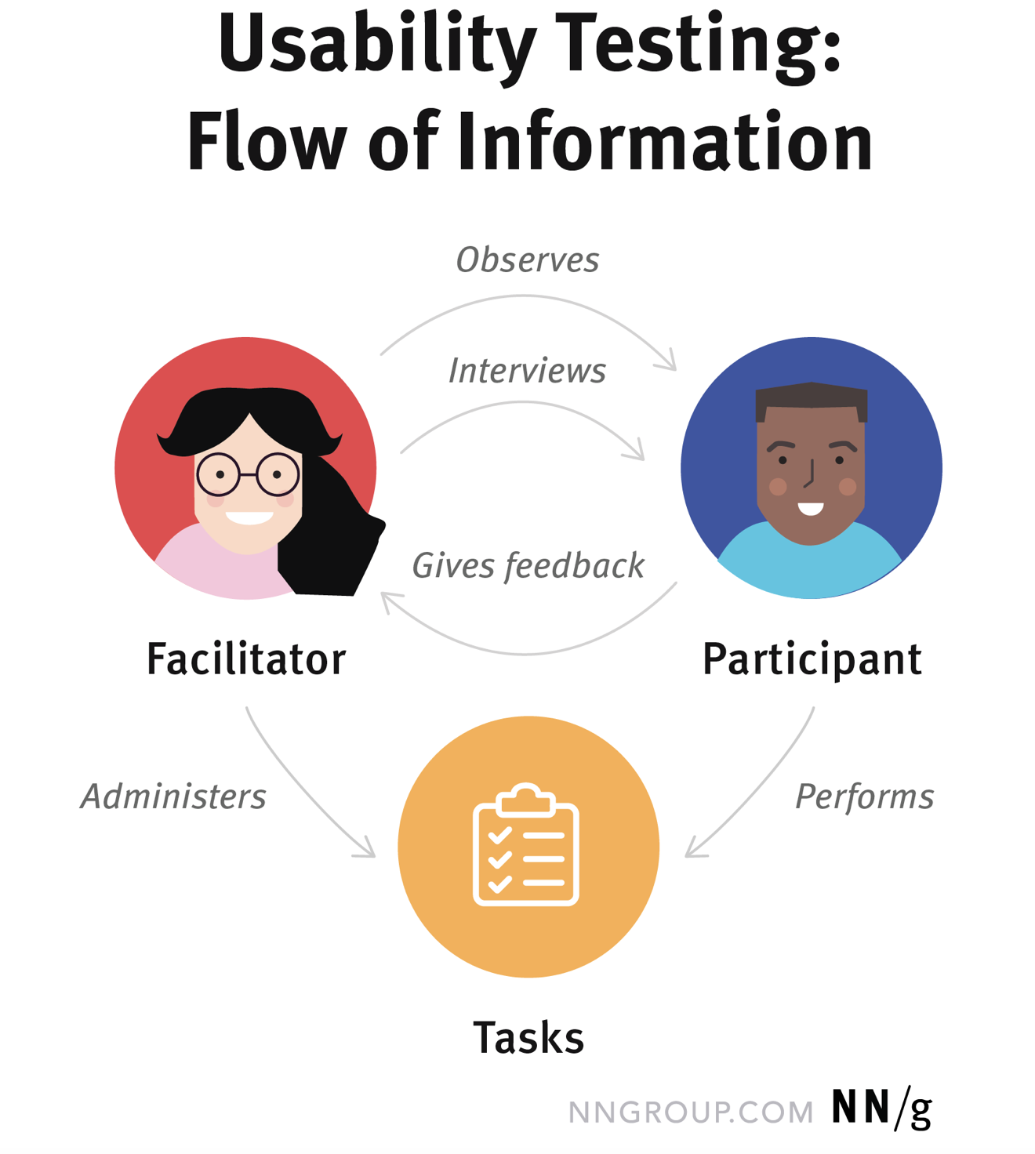
How to conduct user testing?
Facilitator guides the participant through the test process.
Chapter 14. Tognazzini, B. (1992). TOG on Interface. Addison-Wesley Longman Publishing Co., Inc..
Notes:
Use the picture on the right side to explain user testing process

Slide 51
How to conduct user testing?
Facilitator guides the participant through the test process.
You may:
Tell the participant that you are testing the product, not them.
Tell the participant that it is OK to quit at any time.
Explain that you will not provide help.
Ask the participant to think aloud, saying what comes to mind as he or she works.
Describe the scenario(s) and task(s)
Chapter 14. Tognazzini, B. (1992). TOG on Interface. Addison-Wesley Longman Publishing Co., Inc..
Notes:
The facilitator works to ensure that the test results in high-quality, valid data, without accidentally influencing the participant’s behavior.

Slide 52
How to conduct user testing?
Facilitator observes the participant during the test.

Slide 53
How to conduct user testing?
Facilitator observes the participant during the test.
You may:
Record the time it takes for the participant to complete a certain task.
Record whether the participant is able to complete a task or not complete a task, as well as if they struggle at times.
Record interesting quotes from the participant (e.g., expressing satisfaction, frustration, suggestion)
Record nonverbal cues (e.g., facial expression, body language)
Notes:
We can talk a little about quantitative and qualitative data here.

Slide 54
How to conduct user testing?
Facilitator observes the participant during the test.
You may:
Videotape/Screenrecord the session
Audio-record the session
maintain confidentiality and anonymity
Notes:
We don’t require students to record their user testing for class activity any more. We provide information here in case some teams want to record their study for their term project.

Slide 55
How to conduct user testing?
Participant performs task.
Focus on:
Realistic users
In a controlled environment
Feel at ease
Think aloud
If they are stuck, wait and be quiet. If they can’t figure it out, let them explain you why. Eventually, you may move to the next task, but give the participant design a chance to fail.

Slide 56
How to conduct user testing?
Facilitator often interviews the participant after the test (follow-up questions).
What was your first impression?
Was there anything you liked?
Was there anything you did not like?
If there would be one thing you could change, what would it be?

Slide 57
User Study Protocol Drafts
Examples
Good:
Introduction (yourself and project)
Introduction to Scenario and Task
Missing:
Opportunity for Questions
Informed Consent
Think out loud reminder
Notes:
You can explain the example a little. The task is clearly stated, but doesn’t suggest how to complete the task. The participants may need to check help menu on the printer. If you want to test whether the participant can discover help menu themselves or not, you don’t want to mention help menu in your task description.

Slide 58
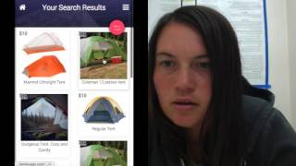
How to conduct user testing?
Notes:
https://unsplash.com/photos/fy5OfU3QV1I

Slide 59
How to conduct user testing?
Introduction ✅
Consent ✅
Video-recording ✅
Scenario & Task ✅
Records the Screen and Participant ✅
Think aloud ✅
Reads out loud the scenario and task ✅
Any Questions? ❌
Notes:
https://unsplash.com/photos/fy5OfU3QV1I

Slide 60
How to analyze user testing?
After user testing, you need to
Categorize and prioritize the identified issues in your Team
Summarize each category and suggest improvements
Issue Prioritization
How many participants did not complete a task?
How many participants had problems in the same task or screen?
Was the problem catastrophic or cosmetic?
Fix critical and frequent problems first.

Slide 61
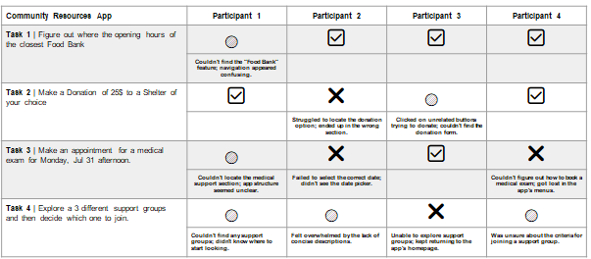
How to analyze user testing?

Slide 62
Project
Create an initial user study protocol for your Group Project and conduct user testing
Suggested Sections:
Short introduction (who are you, what is this about?).
Project description (what is the project about, what is the goal, what is the context?).
Opportunity for questions from your participant.
Introduction to think out loud.
Introduction to your scenarios and tasks.
Thank you and opportunities for questions.
Conduct four user tests

Slide 64
Plan for upcoming classes
Date | Plan
12/9/23
12/12/23 | Studio Time
18/12/23 & 19/12/23 | Presentation & M2 submission
Final Exam | Final report submission

